Slide 1
Developing Tomorrow’s Leaders Today

Slide 2


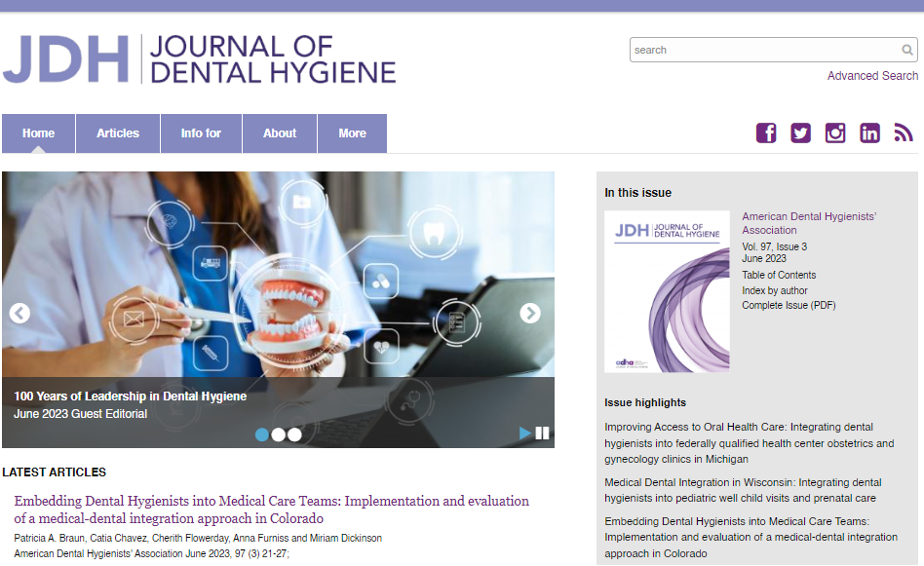
ADHA At-A-Glance
Leading voice in dental hygiene representing the professional interests of 219,000+ RDHs and dental hygiene students nationwide
Annual Conference – dental hygiene’s largest and most respected event, offering first-rate courses, networking and profession-advancing connections
CE Smart – industry-leading, evidence-based live & on-demand education + CE tracking
Institute for Oral Health – the foundation supporting scholarships and grants exclusively for dental hygienists
Journal of Dental Hygiene – published by ADHA, the only peer-reviewed scientific research journal for our profession
Hygienist Hub – ADHA’s newest resource for clinical updates, career strategies, highlights and can’t-miss stories

Slide 3
ADHA’s Strategic Plan
2023-2025
Mission – To unite and empower dental hygienists.
Vision – Healthy people through the power of dental hygienists.
Values
Respect Treat each other with courtesy and respect, encouraging constructive dialogue, assuming good intent in all interactions.
Trust & Integrity Create an environment that advances curious, courageous, innovative and accountable decision-making.
Diversity & Inclusion Support and cultivate an environment of inclusion, diversity, equity, and access.
Engagement Seek robust input to inform wise decisions. Broadly and frequently communicate ADHA strategies, direction and values.
Domains
Community | Continuing Education | Governance & Infrastructure | Advocacy
Provide an engaging, inviting, and supportive space for dental hygienists while celebrating our differences. | Be the leader in developing and delivering dynamic, high quality learning opportunities. | Advance structures that enable strategy development and execution in an inclusive, decisive and competent manner. | Support dental hygienists in a variety of roles. Pursue opportunities to advance the profession.

Slide 4
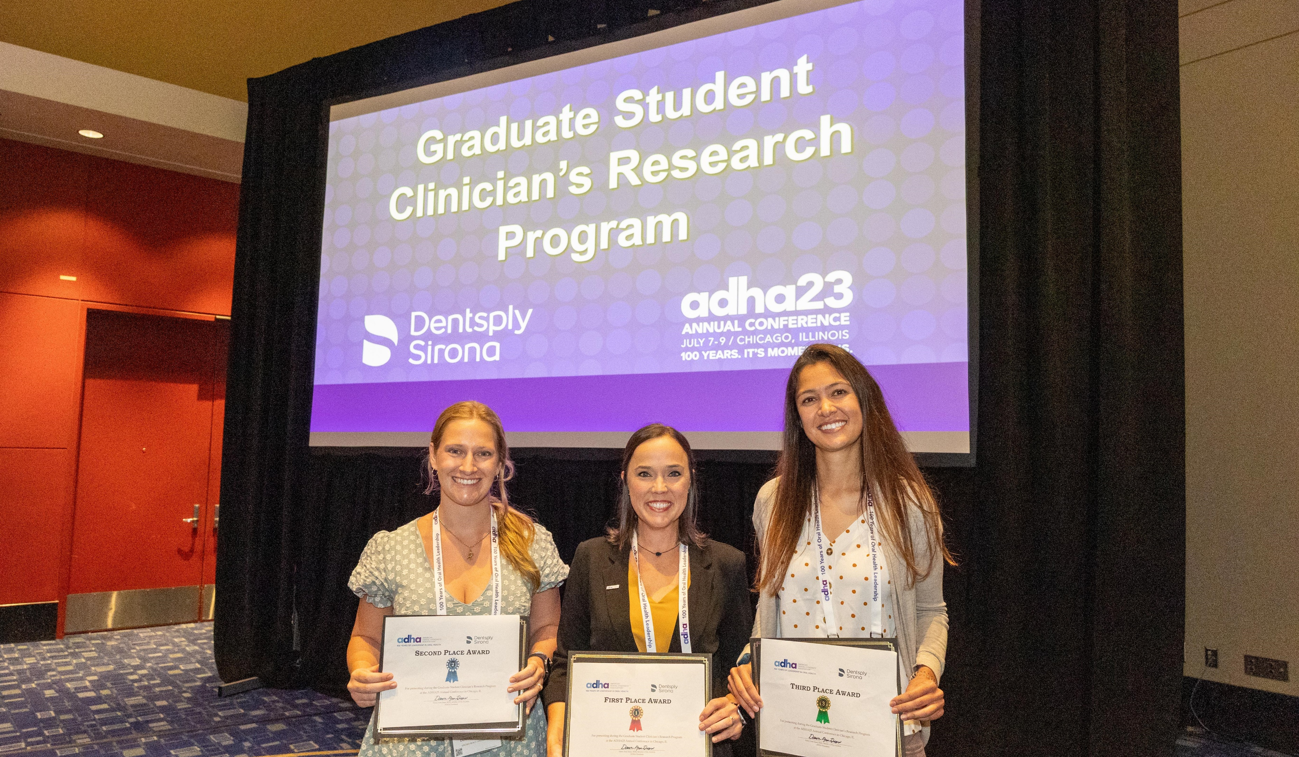


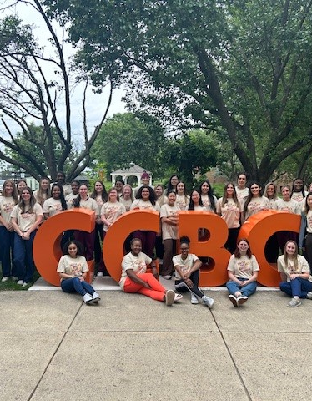
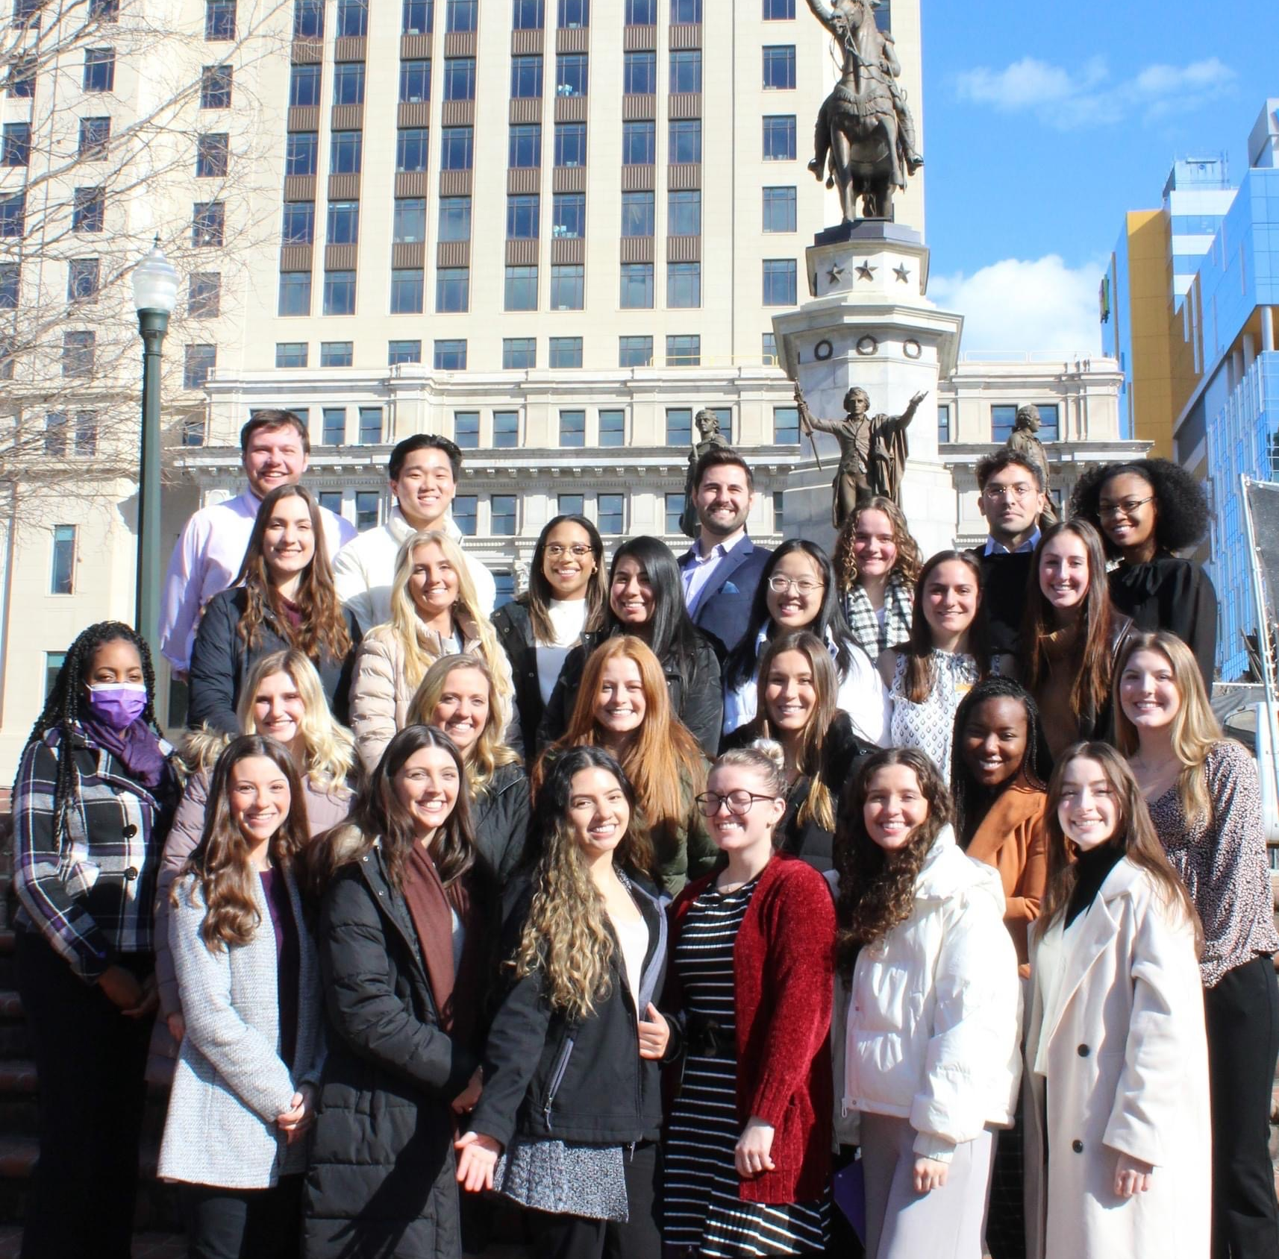
What can ADHA DO FOR ME?

Slide 5

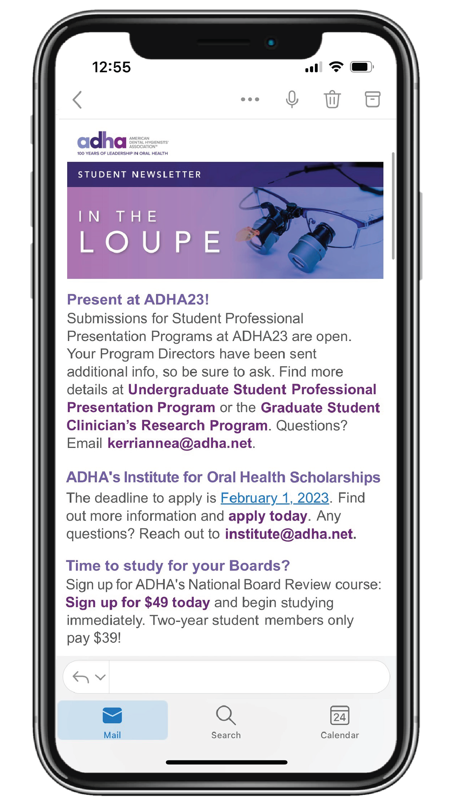
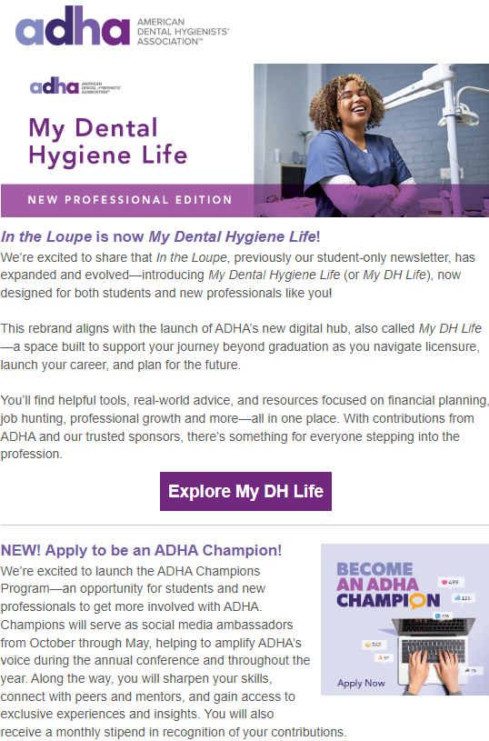
Delivering essential RDH information monthly to your inbox in a need-to-know format!
Fast and easy for on-the-go students.
Notes:
My DH Life Newsletter segmented for our student & new professional members.
Able to quickly glance at the most “need to know” information from ADHA that month and click for more information

Slide 6

Scholarship Opportunities
The ADHA foundation supports students just like you with multiple scholarship opportunities
Deadline: February 28, 2026
for 2026 – 2027 School year
Visit adha.org/foundation for more information

Slide 7

ADHA25 ANNUAL CONFERENCE
October 4 – 6, 2025
Long Beach, CA
A Special Place for Students
Special events and education designed to help dental hygiene students advance their knowledge, network and have a great time including:
Students-Only Reception
Network with fellow students and connect with the nation’s leading dental hygiene professionals.
Student specific courses and select awards competitions

Slide 8

National Board Review (NBR)
Big discounts for ADHA student members!
  $99 for members
  $149 for nonmembers
Bundle with a 2-year membership for $225 and save even more!
  NEW! 1-year membership bundle with NBR for $170.
Forever Access – Unlike any other board prep course on the market – permanent access!
Watch on-demand videos from faculty on all the need-to-know areas of the board exam!
Self-Quizzing – Access the ADHA test question bank and spend as much time as you’d like quizzing yourself.
Ace Your Exam after prepping with ADHA!

Slide 9

Apply to Be an ADHA Champion!
Six Student and/or New Professional members will be selected to serve as social media ambassadors from October through May, sharing the energy and insights from the annual conference and key moments throughout the year.
This opportunity provides individuals a unique chance to support the ADHA, network with industry professionals and broaden their skills! Champions will receive a stipend and other exciting incentives.
Find out more here:
https://www.adha.org/champions/
Notes:
Find out more here: https://www.adha.org/my-dental-hygiene-life/adha-champions

Slide 10

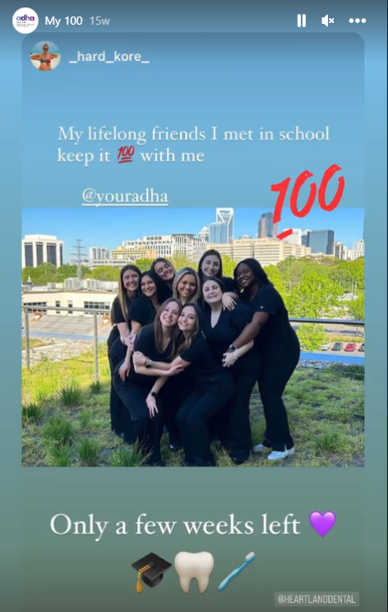
Student proud week
April 13 – 17, 2026
Participate on Instagram. Follow us: @yourADHA
Notes:
Student Proud Week is our time to take a moment to celebrate your accomplishments as students and remind you that your professional association is here to support you every step of the way.
Each year we have some super fun challenges and major prizes ready to send your way. So get ready for Student Proud Week 2022 this April 4-8. Details will be sent to your email and can be found on our Instagram. If you don’t already follow ADHA – what the heck are you waiting for? Instagram will be your portal to show your stuff and get a chance at the prizes.
Be sure you’re following @YourADHA so you don’t miss a beat.

Slide 11
Student Chapter Registration
REQUIREMENTS
BENEFITS
Be part of a dental hygiene program
Have a student leader who is a member of ADHA
Have a faculty member student advisor
Maintain at least 10 active ADHA student members at all times
Chapter featured on ADHA website
Networking and collaboration with other chapters across the country
Opportunities to be featured on ADHA social media channels
Extra perks during Student Proud Week
Chance to win $$ for your chapter by entering the fall video competition or applying for the Outstanding ADHA Student Chapter Awards!
Registration is open annually
August 1 – October 1

Slide 12
We’ve got you covered after graduation too!

Slide 13
New! New Professional Membership
35% off Professional Dues for 2 years!
To celebrate your journey from student to dental hygiene professional, ADHA has created the New Professional membership category, just for next-generation RDHs like you.
We know getting started isn’t always easy so we’re helping you SAVE 35% on member dues for the first two years of your dental hygiene career.
Don’t miss this opportunity for major savings on dues as you kick-off your career.
PLUS enjoy all the amazing savings, connections and benefits that come with ADHA professional membership.

Slide 14
Graduation Gifts for Student Members
6 months free membership!
Hu-Friedy & quip Gifts
After you graduate, ADHA automatically gifts you with a FREE trial professional membership*.
Just be sure to keep your graduation date current on your member profile and update your email and address upon graduation!
Sign up with your correct mailing address and receive free gifts from Hu-Friedy & quip. 2026 grads are receiving a custom mirror handle and a rev 360 oscillating toothbrush!
Keep an eye on your email for alerts when to sign up in the spring!
*Must be an ADHA student member upon graduation to receive these gifts.

Slide 15
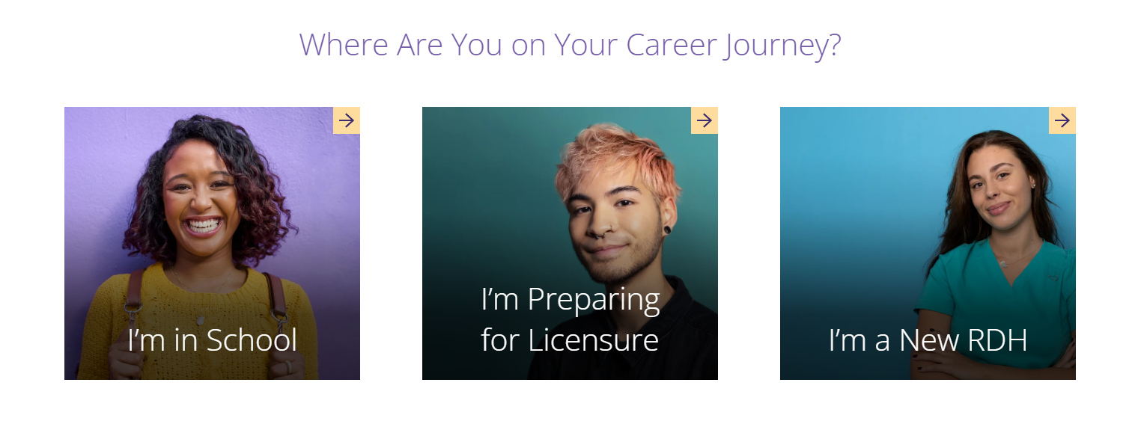
Student & New Professional Resources
My DH Life
You’ll find helpful tools, real-world advice, and resources focused on financial planning, job hunting, professional growth and more—all in one place. With contributions from ADHA and our trusted sponsors, there’s something for everyone stepping into the profession.
Notes:
Packed with resources on everything from financial planning to career growth—and supported by both ADHA and our generous sponsors—My DH Life is your go-to for navigating life as a future RDH.
Job Board - Looking for the perfect position to start your career? Our Career Center is here to help! Using our job board you can quickly search open positions and post your resume online in no time.
Scholarships & more available here: https://www.adha.org/my-dental-hygiene-life/

Slide 16

Meet CE Smart by ADHA
A comprehensive solution that combines high-quality continuing education and CE tracking all in one place. Target the classes you want. Stay current on trending topics.
Plus, with CE Smart Tracker managing your courses, credits, transcripts, and certificates is easy and all in one place. When it comes time for your license renewal, just download your full transcript.

Slide 17
We asked:
What would you tell your younger self?
“You earned your right to learn and succeeded... now make a contribution with your knowledge and passion for dental hygiene as then our profession becomes YOURS. Trust yourself to take calculated risks and be the best RDH you can be ~ wherever the journey takes you!” - Leann Keefer, MSM, RDH
“No matter how hard you try, you can never please everyone and so just let it roll off and continue to be the best, most professional hygienist you know you are.” – Vicki Munday, RDH, BS
“Become a member of ADHA … You won't regret it!” - Sandra Larew, RDH
Notes:
We recently posted a question on the ADHA Facebook page, and some of members answered, “What would you tell your younger self” We thought we’d share a few with you.

Slide 18

You’ve got this!
And we’ve got you.
Welcome to the ADHA family!

