Slide 1
Developing Tomorrow’s Leaders Today

Slide 2
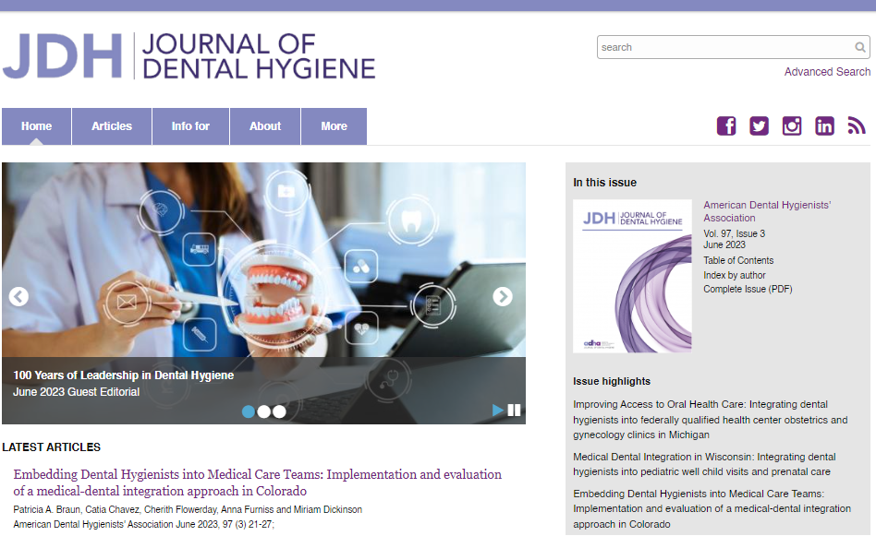
ADHA At-A-Glance
Leading voice in dental hygiene representing the professional interests of 226,000+ RDHs and dental hygiene students nationwide
Annual Conference – dental hygiene’s largest and most respected event, offering first-rate courses, networking and profession-advancing connections
CE Smart – industry-leading, evidence-based live & on-demand education + CE tracking
Institute for Oral Health – the foundation supporting scholarships and grants exclusively for dental hygienists
Journal of Dental Hygiene – published by ADHA, the only peer-reviewed scientific research journal for our profession
Hygienist Hub – ADHA’s newest resource for clinical updates, career strategies, highlights and can’t-miss stories

Slide 3
Happy Birthday, ADHA
ADHA turned 100 years old in 2023!
Year-long celebration is highlighting accomplishments in practice and public health championed by ADHA
We're sharing stories, profiling dental hygiene leaders and focusing on the critical issues to lay the groundwork for the next century of success
Follow Us! @youradha

Slide 4
ADHA’s Strategic Plan
2023-2025
Mission – To unite and empower dental hygienists.
Vision – Healthy people through the power of dental hygienists.
Values
Respect Treat each other with courtesy and respect, encouraging constructive dialogue, assuming good intent in all interactions.
Trust & Integrity Create an environment that advances curious, courageous, innovative and accountable decision-making.
Diversity & Inclusion Support and cultivate an environment of inclusion, diversity, equity, and access.
Engagement Seek robust input to inform wise decisions. Broadly and frequently communicate ADHA strategies, direction and values.
Domains
Community | Continuing Education | Governance & Infrastructure | Advocacy
Provide an engaging, inviting, and supportive space for dental hygienists while celebrating our differences. | Be the leader in developing and delivering dynamic, high quality learning opportunities. | Advance structures that enable strategy development and execution in an inclusive, decisive and competent manner. | Support dental hygienists in a variety of roles. Pursue opportunities to advance the profession.

Slide 5
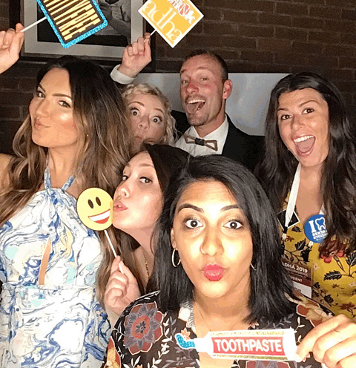
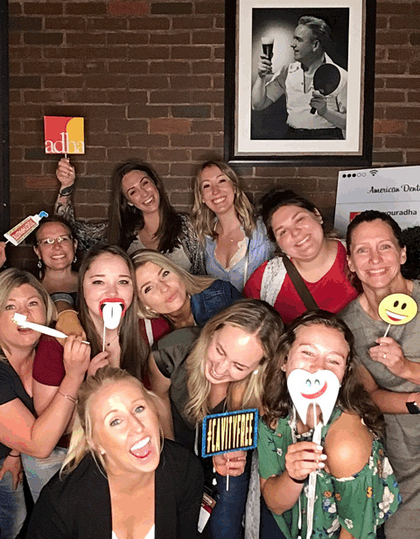
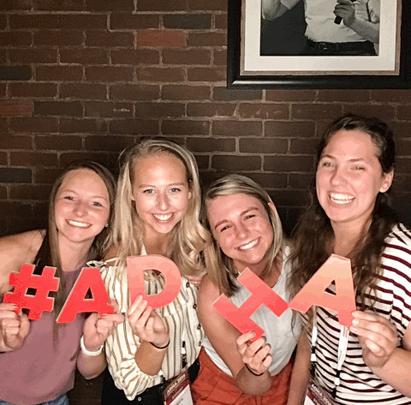
What can ADHA DO FOR ME?

Slide 6
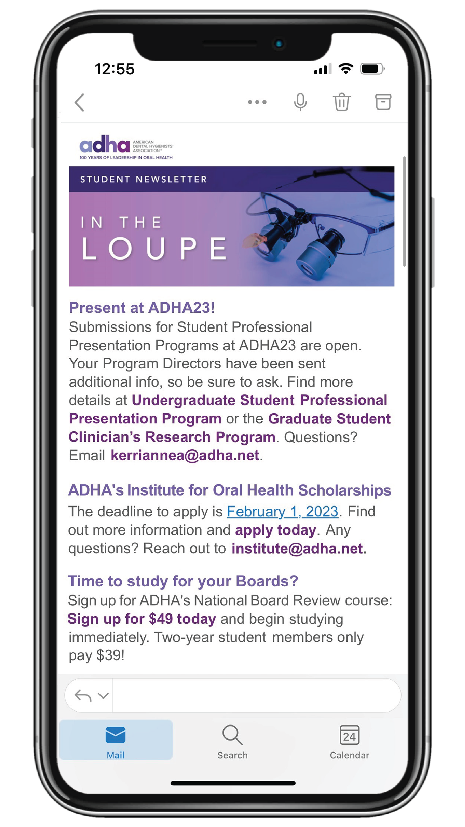
Delivering essential RDH information monthly to your inbox in a need-to-know format!
Fast and easy for on-the-go students.
Notes:
Newsletter just for our student members.
Able to quickly glance at the most “need to know” information from ADHA that month and click for more information

Slide 7
Scholarship Opportunities
The IOH is ADHA’s foundation that supports students just like you with multiple scholarship opportunities
Deadline: February 1, 2024
for 2024 – 2025 School year
Visit adha.org/ioh for more information

Slide 8
ADHA24 ANNUAL CONFERENCE
July 26 – 28, 2024
New Orleans, LA
A Special Place for Students
Special events and education designed to help dental hygiene students advance their knowledge, network and have a great time including:
Students-Only Reception
Network with fellow students and connect with the nation’s leading dental hygiene professionals.
Student specific courses and select awards competitions

Slide 9
National Board Review (NBR)
Big discounts for ADHA student members!
$49 for 1-year members
$39 for 2-year members
$125 for nonmembers
New! Bundle with a 2-year membership for $185 and save even more!
Forever Access – Unlike any other board prep course on the market – permanent access!
Watch On-demand videos from faculty on all the need-to-know areas of the board exam!
Self-Quizzing – Access the ADHA test question bank and spend as much time as you’d like quizzing yourself.
Ace Your Exam after prepping with ADHA!

Slide 10
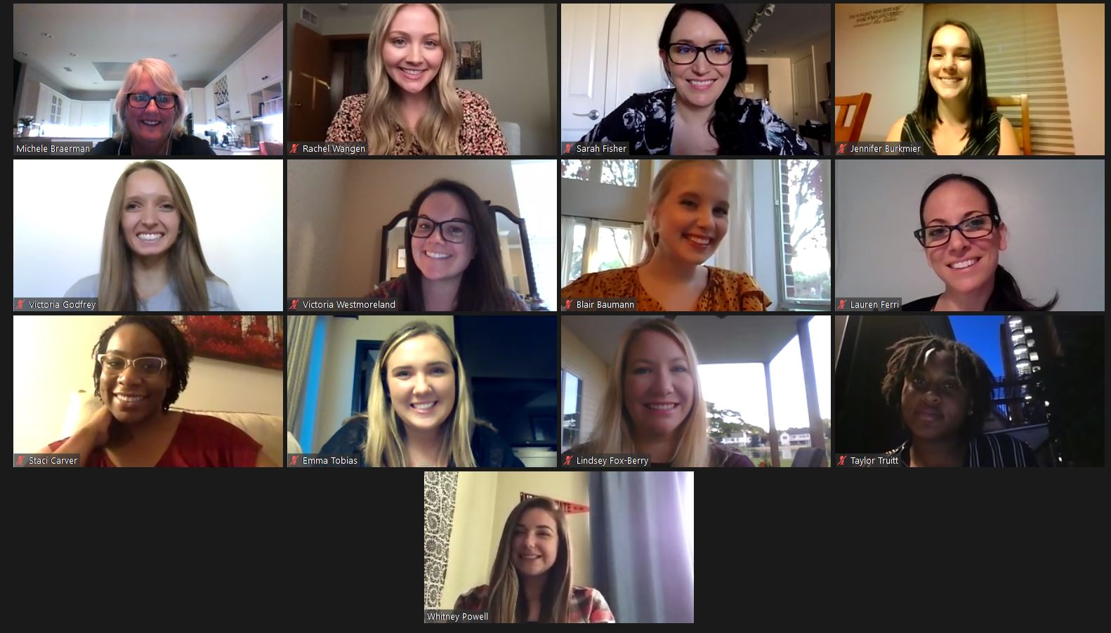
Apply to Be a Student Delegate
One student from each of ADHA’s 12 districts will be selected to attend ADHA’s House of Delegates Meeting and represent their peers.
Applications due
February 9, 2024.
Notes:
Students have a unique opportunity to apply for a position as a Student Delegate. As a Student Delegate, you not only represent all student members of the American Dental Hygienists' Association, but you participate in the House of Delegates during all three meetings.
Student delegates will receive a complimentary conference registration to ADHA 2022.
Must have one term of classes remaining after the meeting to be eligible.

Slide 11
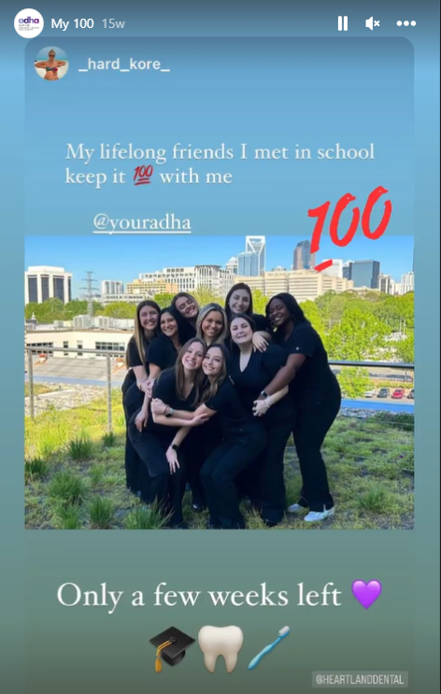
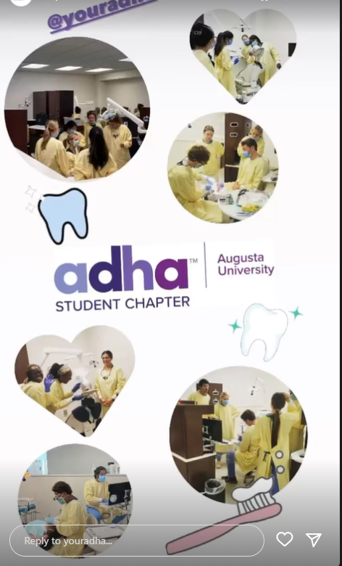
Student proud week
April 15 – 19, 2024
Notes:
Student Proud Week is our time to take a moment to celebrate your accomplishments as students and remind you that your professional association is here to support you every step of the way.
Each year we have some super fun challenges and major prizes ready to send your way. So get ready for Student Proud Week 2022 this April 4-8. Details will be sent to your email and can be found on our Instagram. If you don’t already follow ADHA – what the heck are you waiting for? Instagram will be your portal to show your stuff and get a chance at the prizes.
Be sure you’re following @YourADHA so you don’t miss a beat.

Slide 12
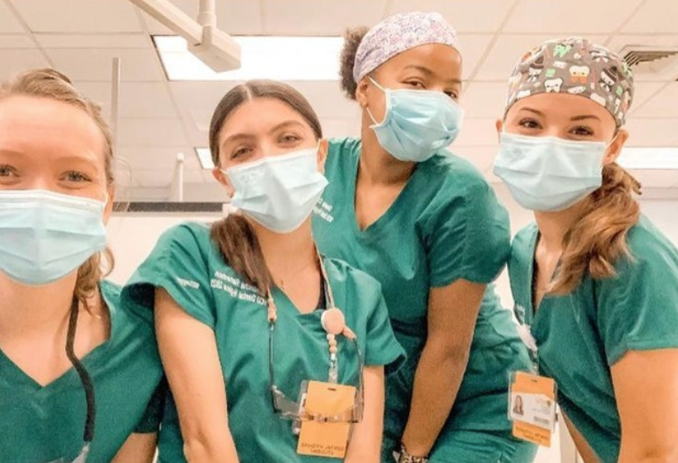
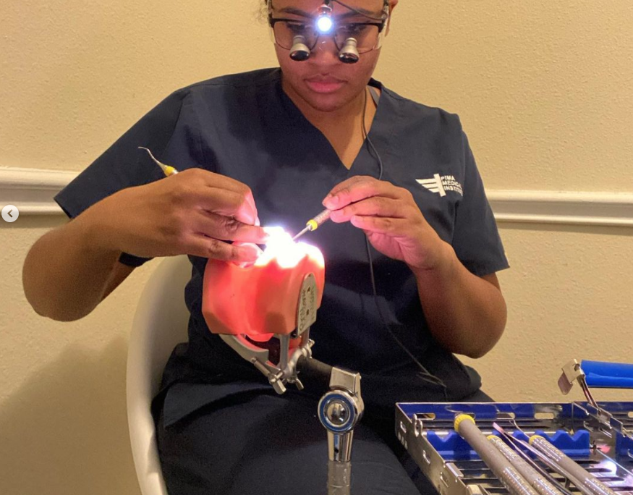
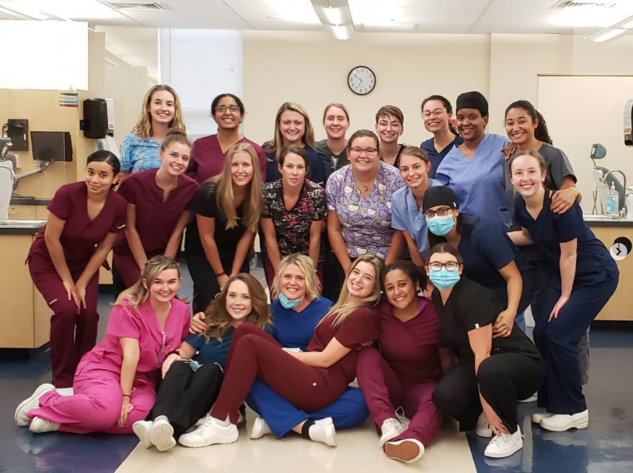
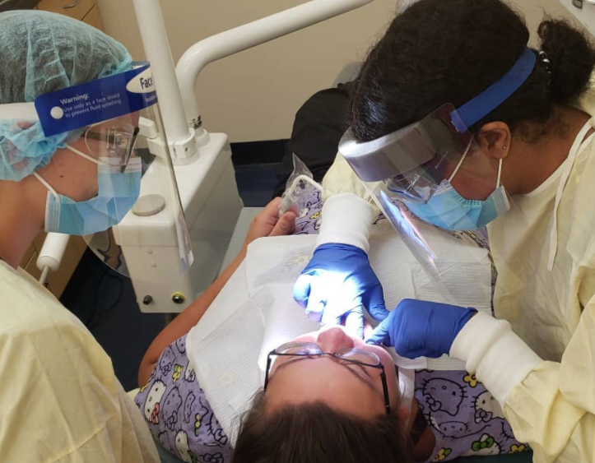
Student Instagram takeovers
@yourADHA
Notes:
Show off what a day in YOUR life as a dental hygiene student looks like by taking over ADHA’s Instagram account for a day!

Slide 13
Student Chapter Registration
REQUIREMENTS
BENEFITS
Be part of a dental hygiene program
Have a student leader who is a member of ADHA
Have a faculty member student advisor
Maintain at least 10 active ADHA student members at all times
Chapter featured on ADHA website
Networking and collaboration with other chapters across the country
Opportunities to be featured on ADHA social media channels
Extra perks during Student Proud Week
Chance to win $$ for your chapter by entering the fall video competition or applying for the Outstanding ADHA Student Chapter Awards!
Registration is open annually
August 1 – October 1

Slide 14
We’ve got you covered after graduation too!

Slide 15
Graduation Gifts for Student Members
6 months free membership!
Hu-Friedy Gift
After you graduate, ADHA automatically gifts you with a FREE trial professional membership*.
Just be sure to keep your graduation date current on your member profile and update your email and address upon graduation!
Sign up with your correct mailing address and receive a free gift* from Hu-Friedy. 2023 grads are receiving a custom mirror handle!
Keep an eye on your email for alerts when to sign up!
*Must be an ADHA student member upon graduation to receive these gifts.

Slide 16
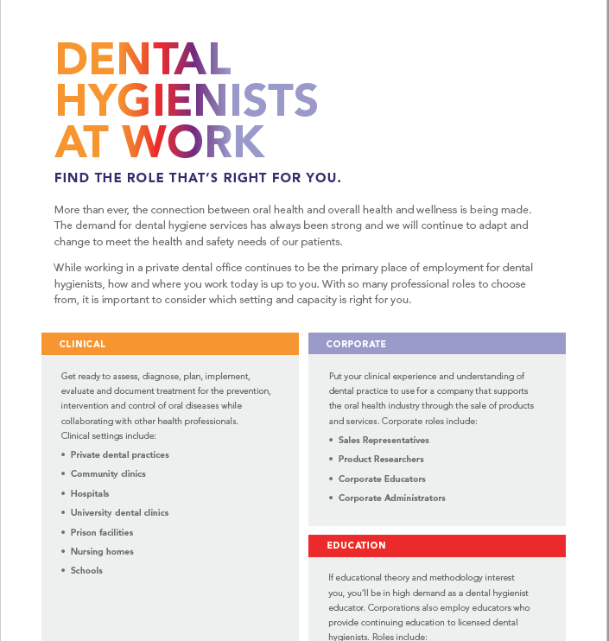
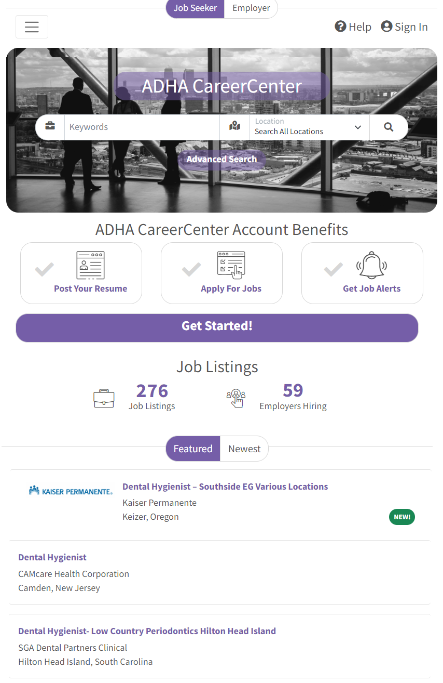
New Professional Resources
Mentor Match
Career Tips
Job Board
Notes:
Mentor Match - Your connection to inspiration, guidance and unconditional support.
At ADHA, we understand the importance of the mentor-mentee relationship. When you enroll in Mentor Match, you have the opportunity to connect with experienced hygienists at a pivotal moment in your career. Above all else, a mentor has complete confidence in your abilities and potential. ADHA is here to help you connect, but from there the relationship is yours to define. Aside from technical skills there is a lot to learn about job searching, navigating relationships with coworkers and patients, teamwork, standards of patient care and more. Whether you are still in school or a new graduate, the right mentor, or mentors, can help you thrive.
Career Tip Sheets – Quick guides to get you the information you need fast! Current topics include How to Interview like a Pro and Roles of a Dental Hygienist. These can be found at adha.org/newprofessionals
Job Board - Looking for the perfect position to start your career? Our Career Center is here to help! Using our job board you can quickly search open positions and post your resume online in no time.

Slide 17
Meet CE Smart by ADHA
A comprehensive solution that combines high-quality continuing education and CE tracking all in one place. Target the classes you want. Stay current on trending topics.
Plus, with CE Smart Tracker managing your courses, credits, transcripts, and certificates is easy and all in one place. When it comes time for your license renewal, just download your full transcript.

Slide 18
We asked: What would you tell your younger self?
“You earned your right to learn and succeeded... now make a contribution with your knowledge and passion for dental hygiene as then our profession becomes YOURS. Trust yourself to take calculated risks and be the best RDH you can be ~ wherever the journey takes you!” - Leann Keefer, MSM, RDH
“No matter how hard you try, you can never please everyone and so just let it roll off and continue to be the best, most professional hygienist you know you are.” – Vicki Munday, RDH, BS
“Become a member of ADHA … You won't regret it!” - Sandra Larew, RDH
Notes:
We recently posted a question on the ADHA Facebook page, and some of members answered, “What would you tell your younger self” We thought we’d share a few with you.

Slide 19
You’ve got this! And we’ve got you.
Welcome to the ADHA family!

