Slide 1
Developing Tomorrow’s Leaders Today

Slide 2
ADHA at-a-Glance
Extensive state and federal advocacy work for the profession
ADHA Annual Conference – the profession’s largest and most respected conference
CE Smart – CE tracking, on-demand online CE database, and regular webinars
In the Loupe – Monthly Student E-newsletter
ADHA Institute for Oral Health – The Foundation for Dental Hygienists by Dental Hygienists
Journal of Dental Hygiene – the peer-reviewed scientific research journal for our profession

Slide 3
Happy Birthday, ADHA
ADHA is turning 100 years old in 2023!
Year-long celebration will highlight accomplishments in practice and public health championed by ADHA
We're sharing stories, profiling dental hygiene leaders and focusing on the critical issues to lay the groundwork for the next century of success

Slide 4
ADHA’s Mission – To unite and empower dental hygienists to enhance the public’s oral and overall health.
Vision – Dental hygienists are valued and recognized for their ability to improve the public’s health.
Values
Respect Treat each other with courtesy and respect, encouraging constructive dialogue, assuming good intent in all interactions.
Trust & Integrity Create an environment that advances curious, courageous, innovative and accountable decision-making.
Diversity & Inclusion Support and cultivate an environment of inclusion, diversity, equity, and access.
Engagement Seek robust input to inform wise decisions. Broadly and frequently communicate ADHA strategies, direction and values.
Domains
Community | Continuing Education | Governance & Infrastructure | Advocacy
Provide an engaging, inviting, and supportive space for dental hygienists. Celebrate differences. | Be the leader in developing and delivering dynamic, high quality learning opportunities. | Advance structures that enable strategy development and execution in an inclusive, decisive and competent manner. | Support dental hygienists in a variety of roles. Pursue opportunities to advance the profession. Promote the recognition, awareness and importance of dental hygienists.
ADHA’s Strategic Plan

Slide 5
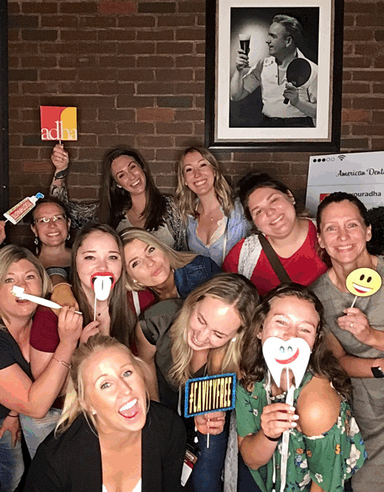
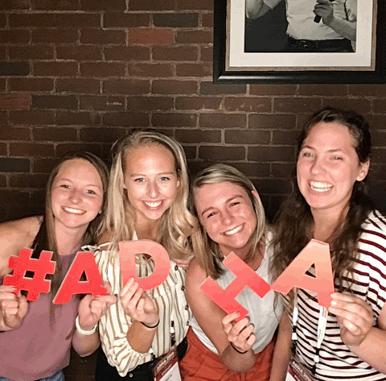
What can ADHA DO FOR ME?

Slide 6
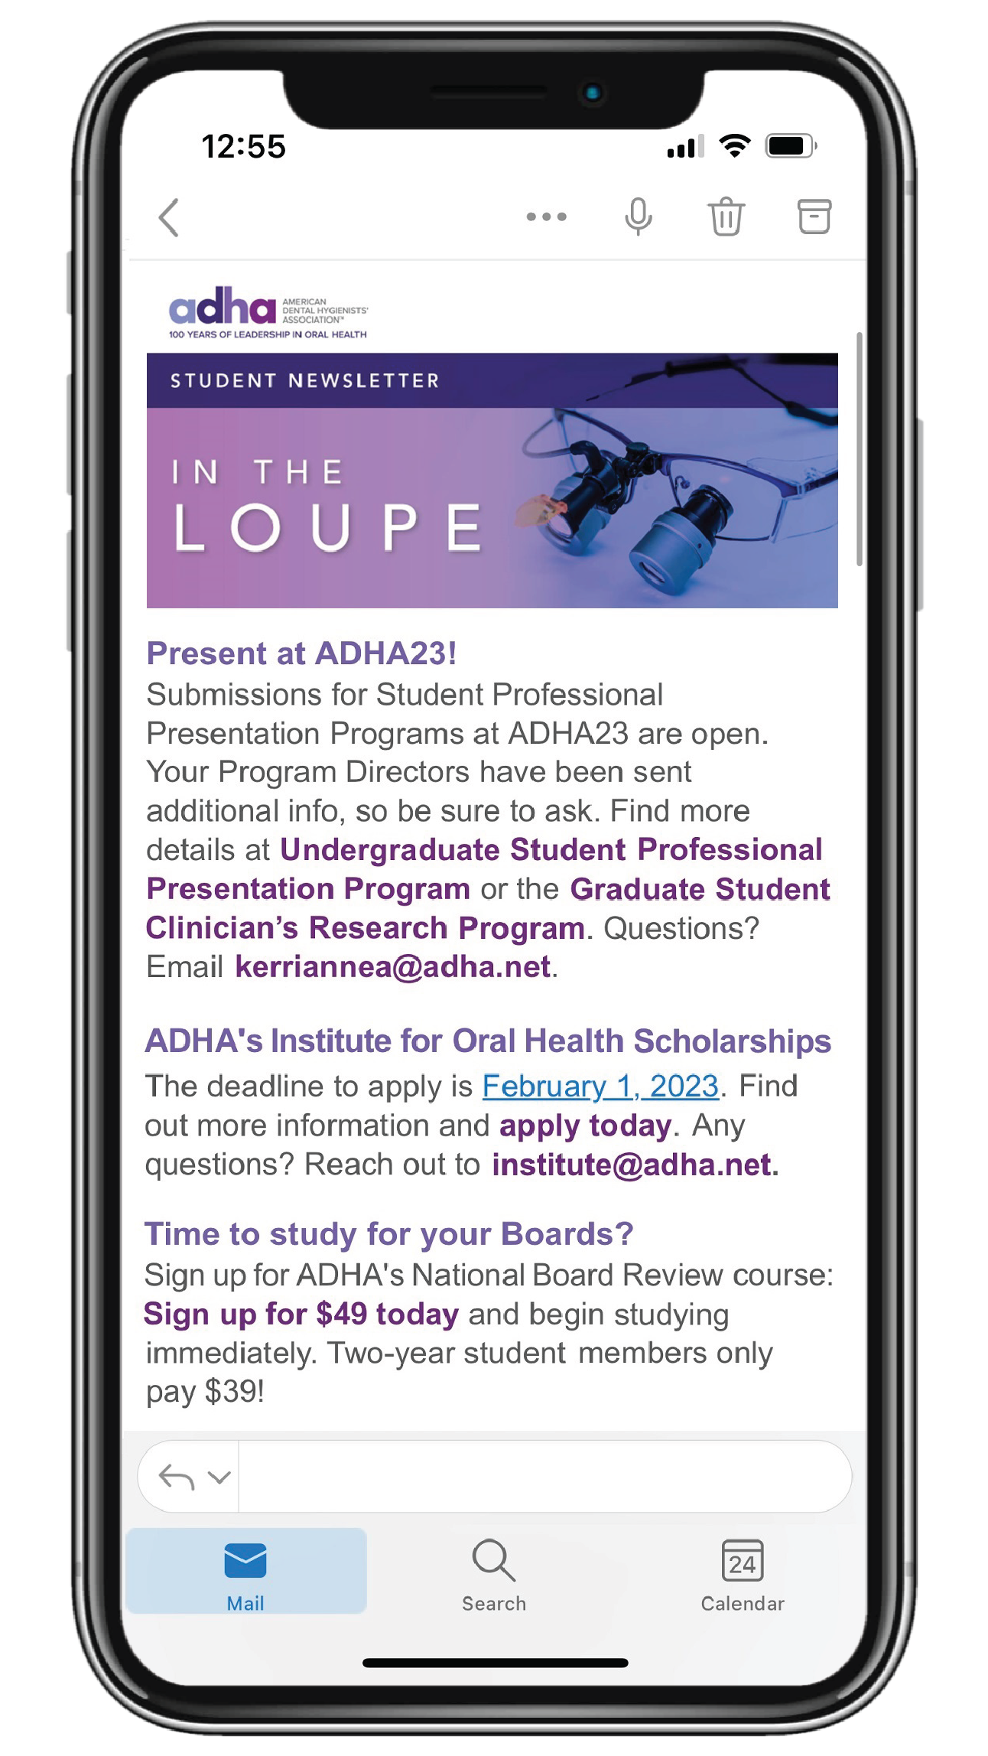
Delivering essential RDH information monthly to your inbox in a need-to-know format!
Fast and easy for on-the-go students.
Notes:
Newsletter just for our student members.
Able to quickly glance at the most “need to know” information from ADHA that month and click for more information

Slide 7
Scholarship Opportunities
The IOH is ADHA’s foundation that supports students just like you with multiple scholarship opportunities
Deadline: February 1, 2023
for 2023 – 2024 School year
Visit adha.org/ioh for more information

Slide 8
ADHA23 ANNUAL CONFERENCE
FRIDAY, JULY 7 - SUNDAY, JULY 9
CHICAGO, IL
A Special Place for Students
Special events and education designed to help dental hygiene students advance their knowledge, network and have a great time including:
Students-Only Reception
Network with fellow students and connect with the nation’s leading dental hygiene professionals.
Student specific courses and select awards competitions

Slide 9
National Board Review Course
Big discounts for ADHA student members!
$49 for 1-year members
$39 for 2-year members
$125 for nonmembers
Unlike any other board prep course on the market - you receive access forever!
Watch on-demand videos from faculty members on all the need-to-know areas of the board exam!
Access the ADHA test question bank and spend as much time as you’d like quizzing yourself.
Ace your exam after prepping with ADHA!

Slide 10
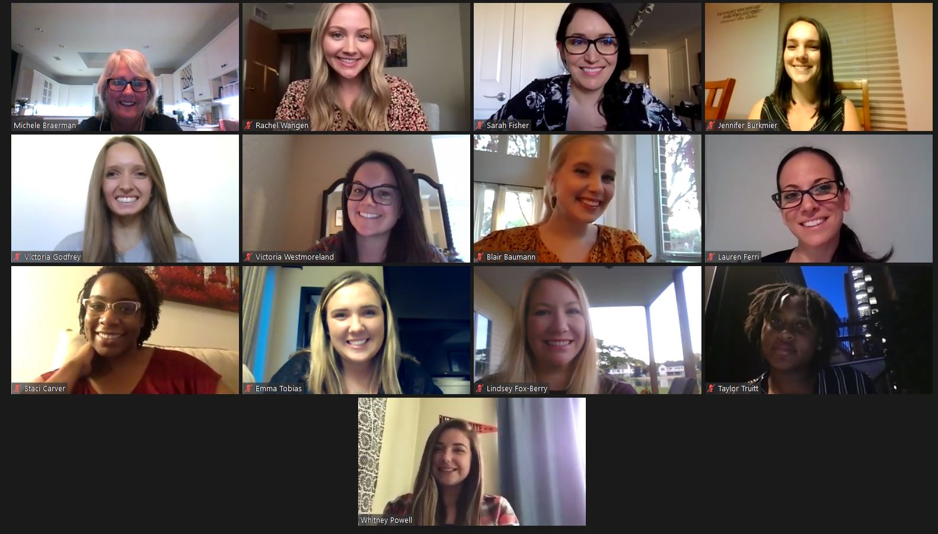
Apply to be a Student Delegate
One student from each of ADHA’s 12 districts will be selected to attend ADHA’s House of Delegates Meeting and represent their peers.
Applications due
February 10, 2023.
Notes:
Students have a unique opportunity to apply for a position as a Student Delegate. As a Student Delegate, you not only represent all student members of the American Dental Hygienists' Association, but you participate in the House of Delegates during all three meetings.
Student delegates will receive a complimentary conference registration to ADHA 2022.
Must have one term of classes remaining after the meeting to be eligible.

Slide 11
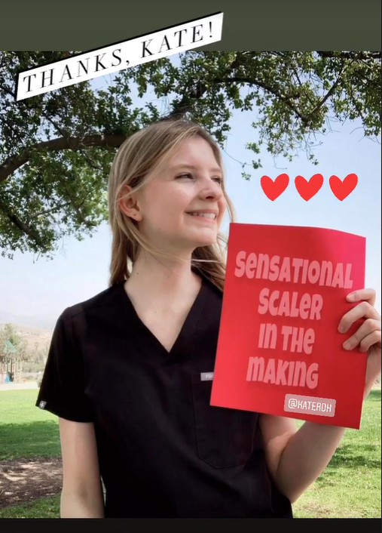
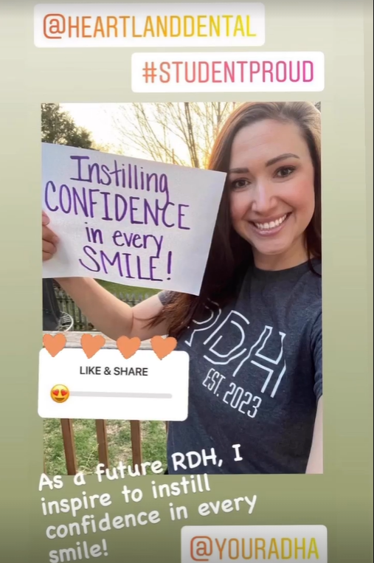
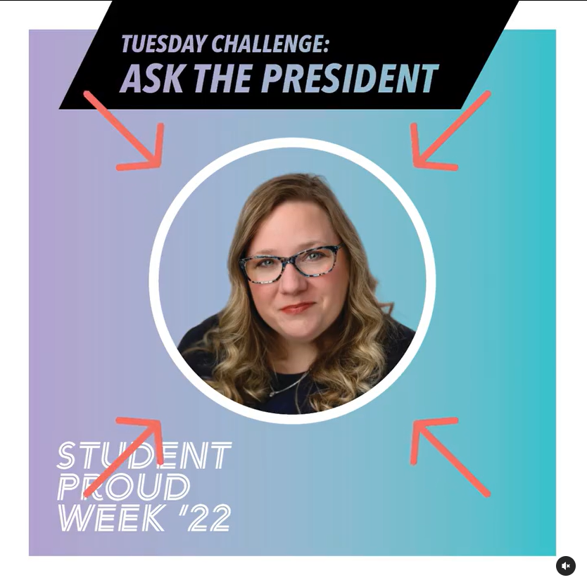
Student proud week
Show your dental hygiene pride with our daily Instagram challenges!
#DHStudentProud 2023:
April 17 - 21
Notes:
Student Proud Week is our time to take a moment to celebrate your accomplishments as students and remind you that your professional association is here to support you every step of the way.
Each year we have some super fun challenges and major prizes ready to send your way. So get ready for Student Proud Week 2022 this April 4-8. Details will be sent to your email and can be found on our Instagram. If you don’t already follow ADHA – what the heck are you waiting for? Instagram will be your portal to show your stuff and get a chance at the prizes.
Be sure you’re following @YourADHA so you don’t miss a beat.

Slide 12
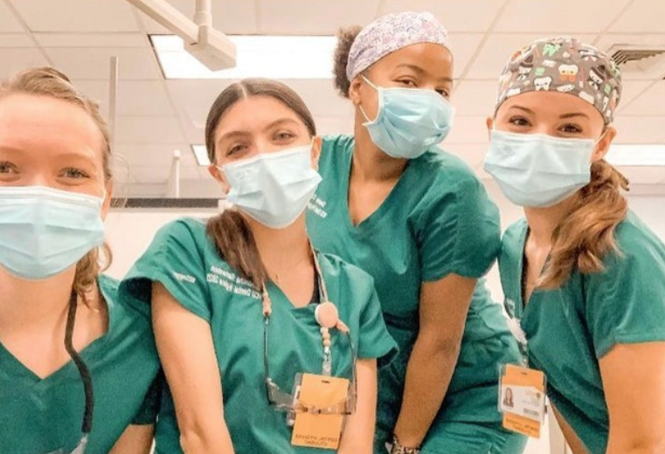
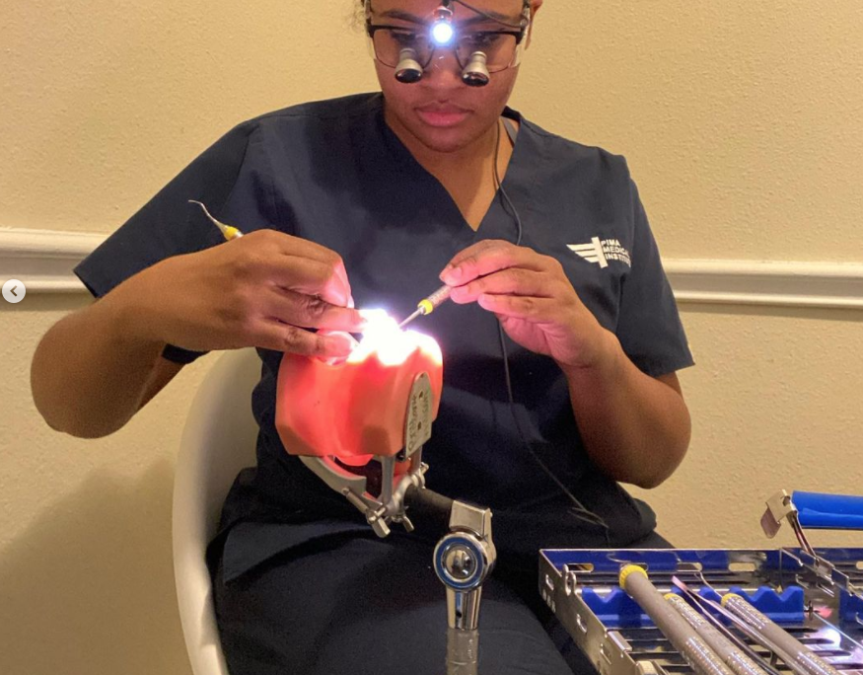
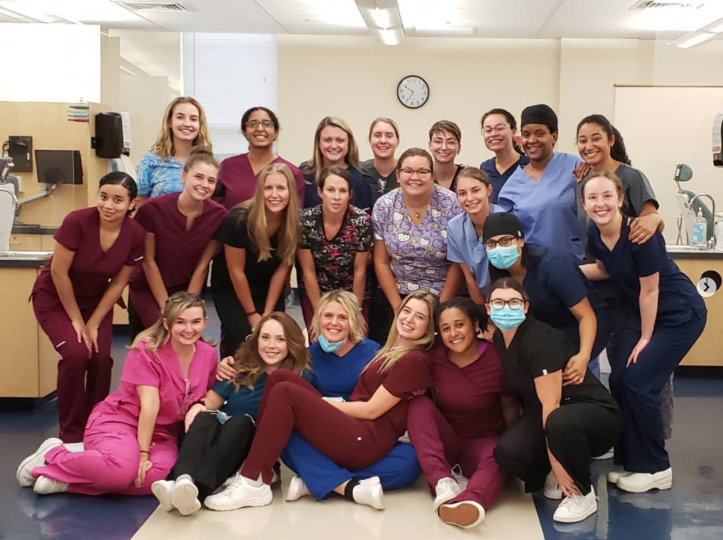
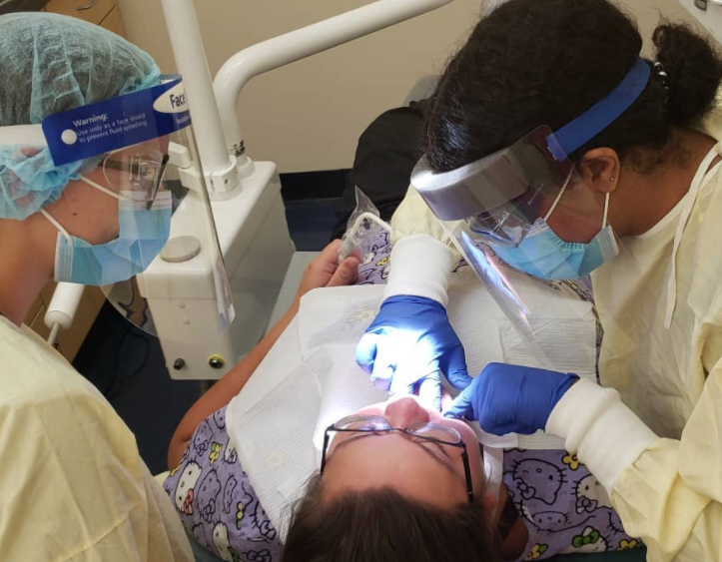
Student Instagram takeovers
@yourADHA
Notes:
Show off what a day in YOUR life as a dental hygiene student looks like by taking over ADHA’s Instagram account for a day!

Slide 13
STUDENT CHAPTER REGISTRATION
Requirements
Benefits
Be part of a dental hygiene program
Have a student leader who is a member of ADHA
Have a student advisor
Maintain at least 10 active ADHA student members at all times
Chapter featured on ADHA website
Networking and collaboration with other chapters across the country
Opportunities to be featured on ADHA social media accounts
Access to chapter toolkit updated annually
Receive extra recognition during DH Student Proud Week
Chance to win $$ for your chapter by entering the fall video competition or applying for the Outstanding ADHA Student Chapter Awards!
Registration open annually
August 1 – October 1

Slide 14
We’ve got you covered after graduation too!

Slide 15
6+ months free membership!
After you graduate, ADHA automatically gifts you with a FREE trial professional membership.*
Be sure to keep your graduation date current on your member profile and update your email and address upon graduation!
*Must be an ADHA student member upon graduation to receive trial membership.

Slide 16
Graduation Gifts for Student Members
6 months free membership!
Hu-Friedy Gift
After you graduate, ADHA automatically gifts you with a FREE trial professional membership.
Just be sure to keep your graduation date current on your member profile and update your email and address upon graduation!
Simply sign up with your correct mailing address and receive a free gift from Hu-Friedy. 2022 grads are receiving a custom mirror handle!
Keep an eye on your email to know when to sign up!
*Must be an ADHA student member upon graduation to receive these gifts.

Slide 17
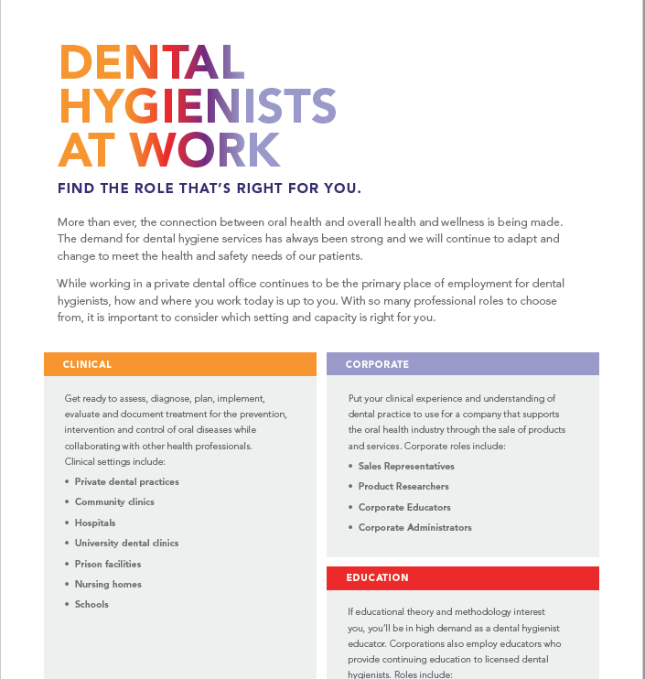
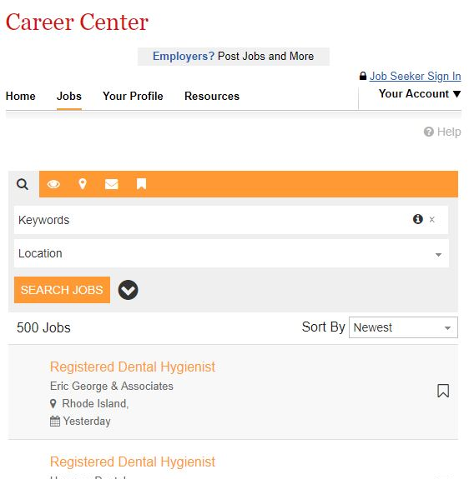
New Professional Resources
Mentor Match
Career Tip Sheets
Job Board
Notes:
Mentor Match - Your connection to inspiration, guidance and unconditional support.
At ADHA, we understand the importance of the mentor-mentee relationship. When you enroll in Mentor Match, you have the opportunity to connect with experienced hygienists at a pivotal moment in your career. Above all else, a mentor has complete confidence in your abilities and potential. ADHA is here to help you connect, but from there the relationship is yours to define. Aside from technical skills there is a lot to learn about job searching, navigating relationships with coworkers and patients, teamwork, standards of patient care and more. Whether you are still in school or a new graduate, the right mentor, or mentors, can help you thrive.
Career Tip Sheets – Quick guides to get you the information you need fast! Current topics include How to Interview like a Pro and Roles of a Dental Hygienist. These can be found at adha.org/newprofessionals
Job Board - Looking for the perfect position to start your career? Our Career Center is here to help! Using our job board you can quickly search open positions and post your resume online in no time.

Slide 18
Meet CE Smart by ADHA
A comprehensive solution that combines high-quality continuing education and CE tracking all in one place. Target the classes you want. Stay current on trending topics.
Plus, with CE Smart Tracker managing your courses, credits, transcripts, and certificates is easy and all in one place. When it comes time for your license renewal, just download your full transcript.

Slide 19
We asked: What would you tell your younger self?
“You earned your right to learn and succeeded... now make a contribution with your knowledge and passion for dental hygiene as then our profession becomes YOURS. Trust yourself to take calculated risks and be the best RDH you can be ~ wherever the journey takes you!” - Leann Keefer
“No matter how hard you try, you can never please everyone and so just let is roll off and continue to be the best, most professional hygienist you know you are.” – Vicki Munday
“Become a member of ADHA … You won't regret it!” - Sandra Larew
Notes:
We recently posted a question on the ADHA Facebook page, and some of members answered, “What would you tell your younger self” We thought we’d share a few with you.

Slide 20
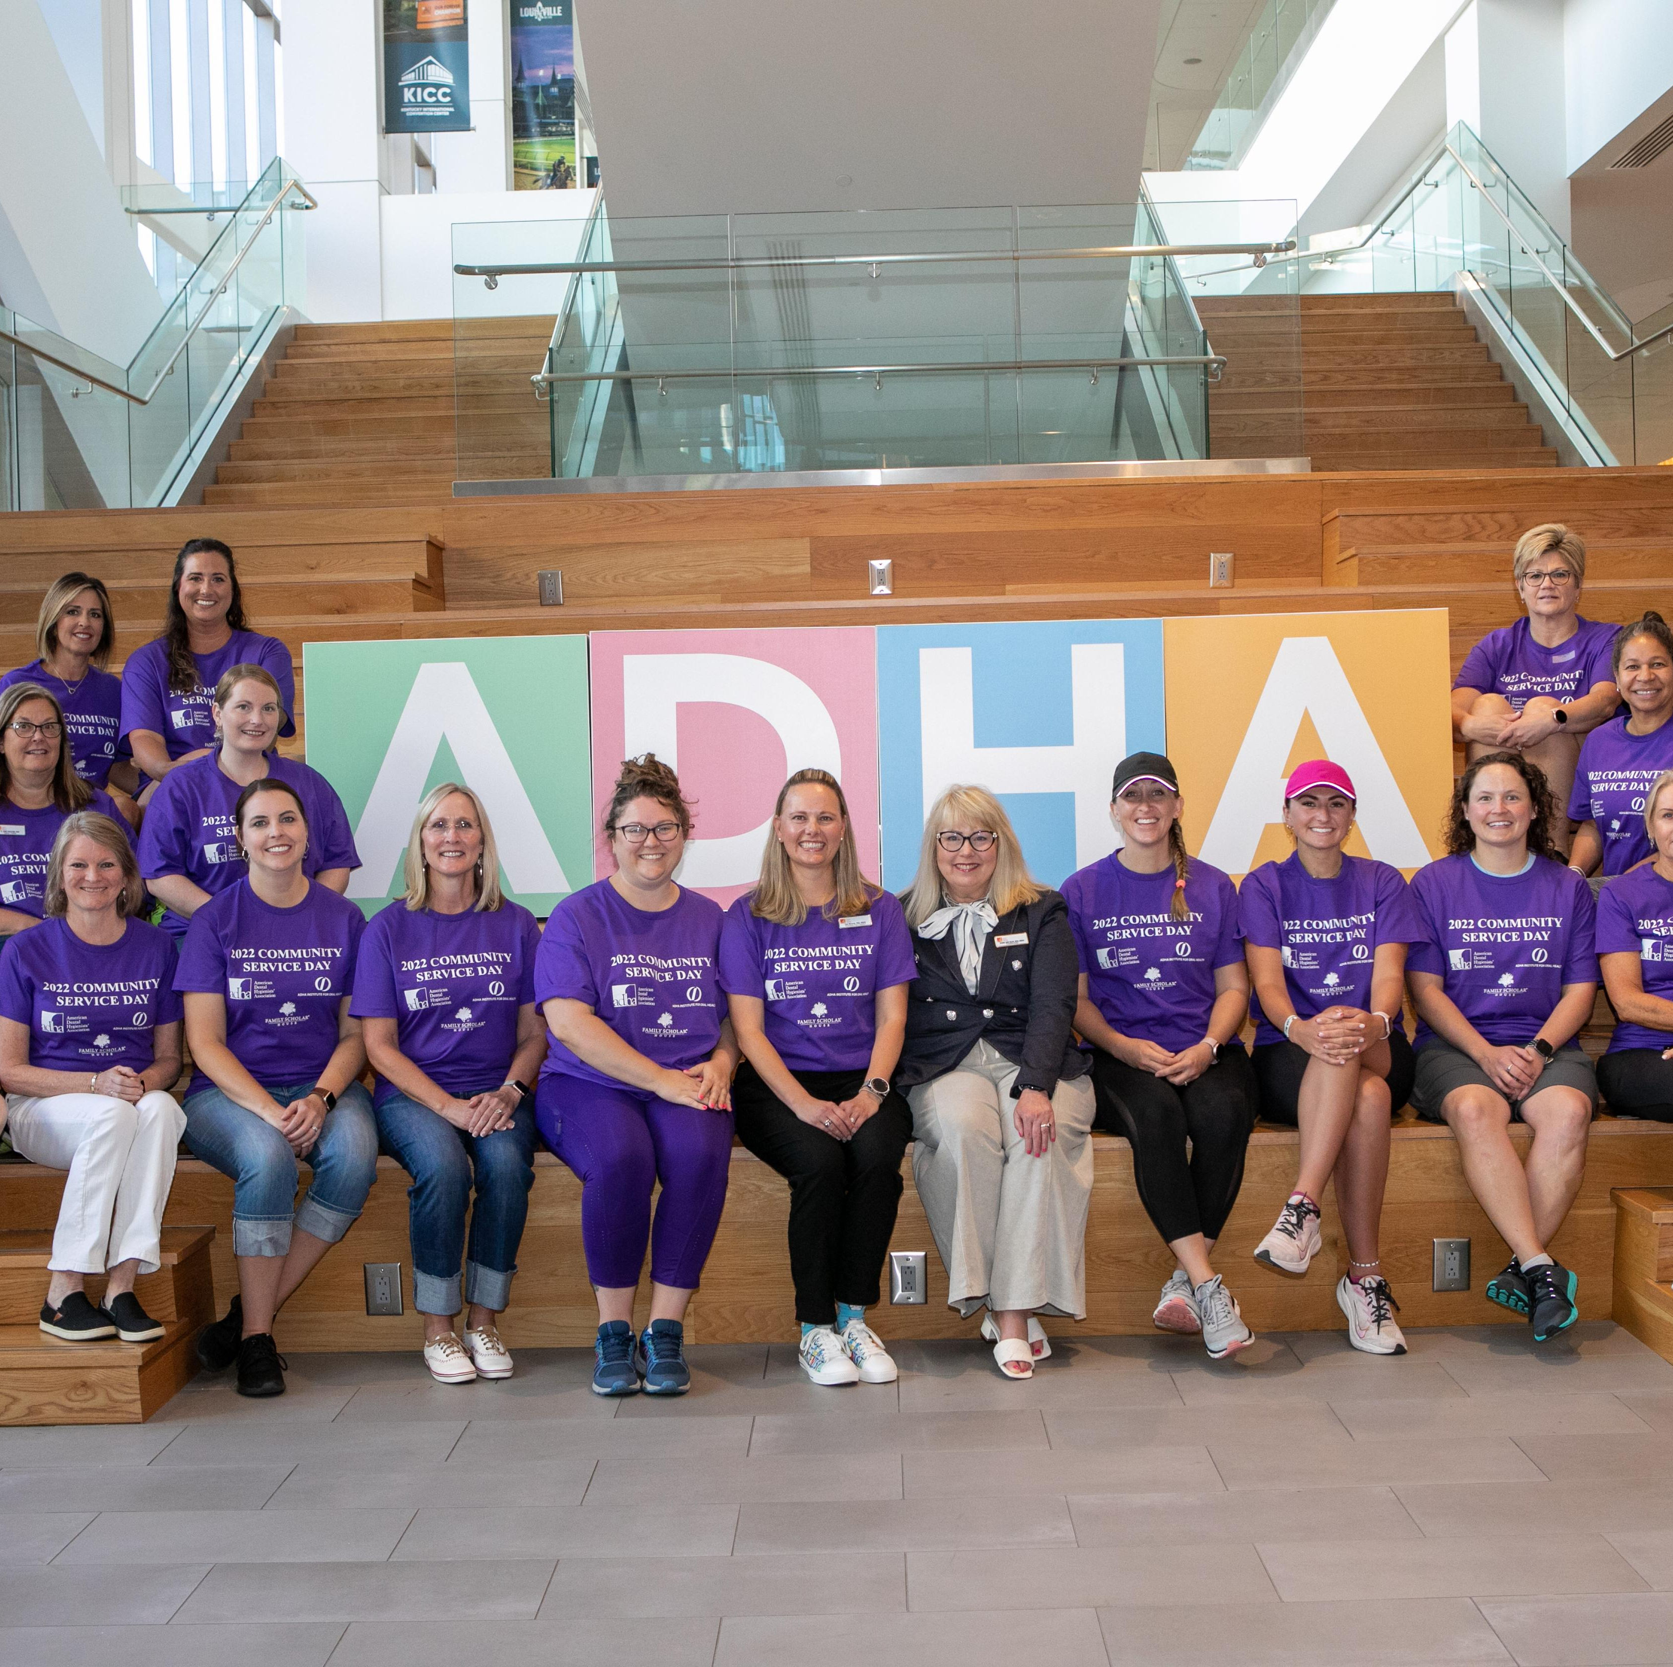
Welcome to the ADHA family – you’ve got this!

